Slide 1

Initial Plan Presentation (Group 6)
Members: Jericho Yantz, Zayd Sani, Nicholas Richardson, Nathan Turner

Slide 2
Introduction
Ever want to blow off some steam or just sit back and enjoy vintage arcade games for free?!? Well, GameNet is the site for you. Our target Audience are kids, students or workers, people who just want to have fun, bored at work or just need something to do.

Slide 3
Topic
Our goal is to create a website that will host different arcade based javascript games that we create in java language.
Tentative game ideas:
Pong
Snake
Pacman
Minesweeper
and more if time allows

Slide 4
Framework/Resources
The main Framework/Resources we will be using are:
Eclipse for programming
Visual Studio Code for file editing
Unsplash Photos for copyright free pictures
Using Teams to communicate and host meetings
Using Slack for Code Sharing

Slide 5
Team Member Responsibilities
Jericho: Responsible for creating and hosting our website and potentially creating a javascript game if time allows
Zayd, Nicholas, and Nathan: Responsible for creating a game and/or games in javascript each, and help test website functionality

Slide 6
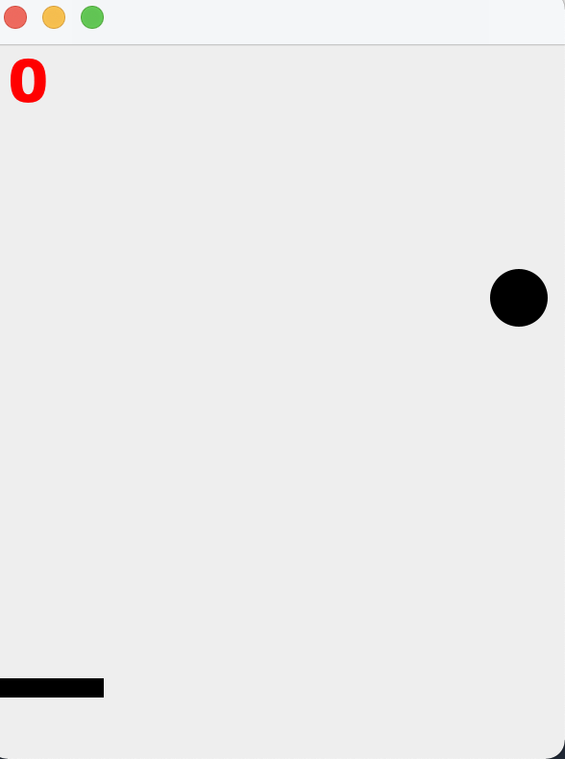
Mini-Tennis
Single player game where user has to keep ball above the line that the user controls. The game ends when the user can't hit the ball in time.
The challenging part is that game is designed to casually speed up as the game progresses
We will try to add more elements to it each meeting to make it more challenging

Slide 7
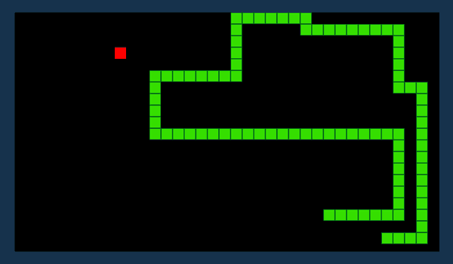
Snake Game
Single player game
Goal of the game is to eat as much food as possible to grow
The player must avoid hitting the sides or itself or the game will be over

Slide 8
Pong Game
This is a multiplayer game.
The goal of the game is to knock the ball past the other players bar.
Players must prevent the ball from passing their bar.

Slide 9
Website Hosting
Using GitHub Pages, we should be able to host our Arcade Game style website for free.
They offer an easy-to-use experience, that allows for learning and code sharing, all for free.

Slide 10
Our Website Plan-
We are going to be showing you our website so far, as well as our ideas for the future of it!

Slide 11
Environment/Programming Language
Javascript
CSS3
HTML5

Slide 12
Schedule
We are going to try to meet twice a week outside of class, specifically Mondays and Fridays at 2:00pm
February 19: Complete project proposal
March 8: 1st midterm presentation
April 2: 2nd midterm presentation
April 23: End of semester presentation
April 28: Design documentation

